Slide 1





INTERNET
TECHNOLOGIES
MULTI-AS INTERNET ARCHITECTURE WITH
BGP, OSPF, VLANS, SERVICES AND SECURITY
Student: Ișfan Ștefan
Programme of study: Physics applied in smart technologies and communications (Master - Second Year)
"Alexandru Ioan Cuza" University of Iaşi - Faculty of Physics
Academic Year: 2025-2026

Slide 2
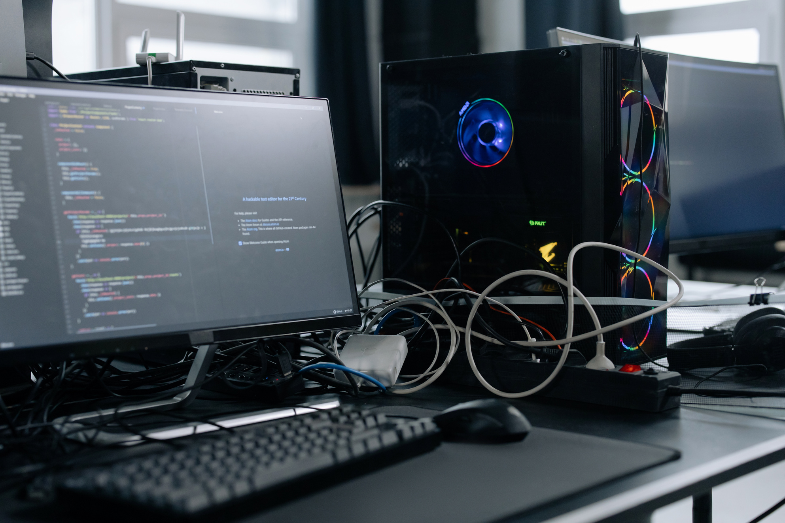
INTERNET
TECHNOLOGIES
WHY DOES THIS
NETWORK EXIST?
CIA Triad: Confidentiality, integrity, availability
Need to protect IT resources and services
Need for redundancy and advanced routing policies
CIA Visual: CIA diagram (triangle or simple table)

Slide 3
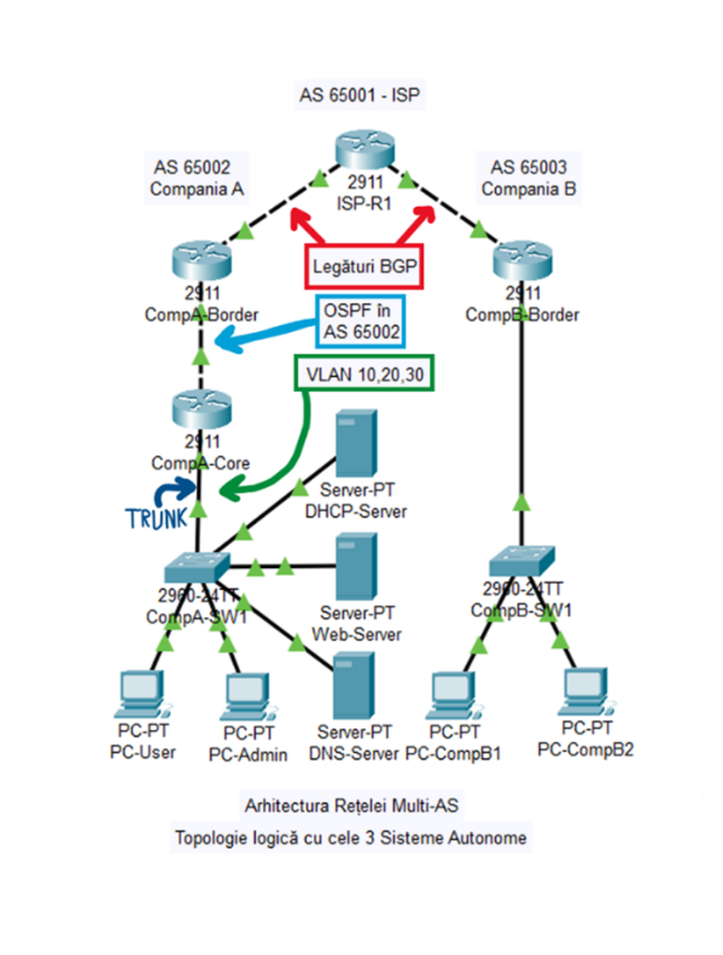
INTERNET
TECHNOLOGIES
COMPLETE
TOPOLOGY

Slide 4
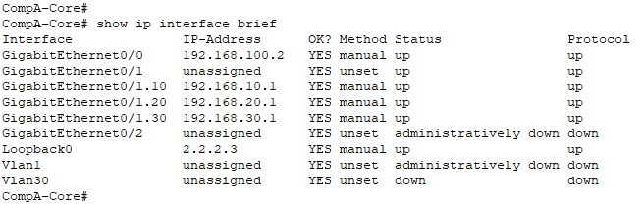
IP ADDRESSING
INTERNET
TECHNOLOGIES
Segment | Network | Gateway | Usage
ISP ↔ CompA | 10.0.1.0/30 | 10.0.1.1 (ISP) 10.0.1.2 (Border) | eBGP Link
ISP ↔ CompB | 10.0.2.0/30 | 10.0.2.1 (ISP) 10.0.2.2 (Border) | eBGP Link
CompA Border ↔ Core | 192.168.100.0/30 | 192.168.100.1 (Border) 192.168.100.2 (Core) | iBGP/OSPF Link
VLAN 10 (Admin) | 192.168.10.0/24 | 192.168.10.1 | Privileged users
VLAN 20 (Servers) | 192.168.20.0/24 | 192.168.20.1 | DNS, Web, DHCP
VLAN 30 (Users) | 192.168.30.0/24 | 192.168.30.1 | Regular users
CompB LAN | 172.16.1.0/24 | 172.16.1.1 | Simple internal network
Networking for maximum efficiency
Clear separation of broadcast domains
Ground rules for private IP addresses
Unique gateways on each segment

Slide 5
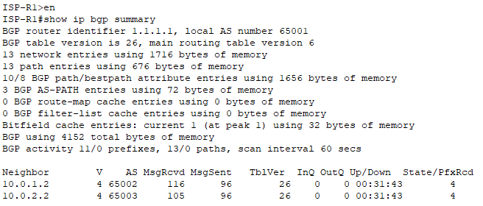
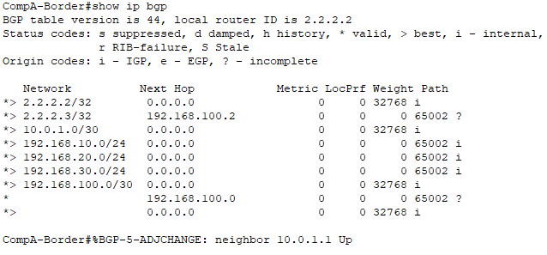
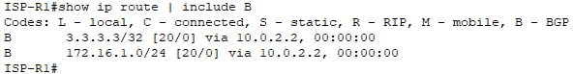
INTERNET
TECHNOLOGIES
EBGP - INTERNET PROTOCOL

Slide 6
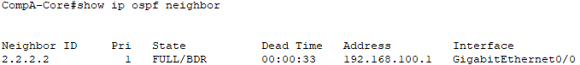
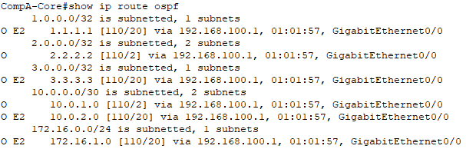
OSPF
INTERNET
TECHNOLOGIES
State: FULL → full synchronization
Routes to ISP are in OSPF
Metrics show logical topology
The basis for future redundancy

Slide 7
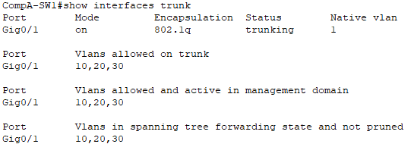
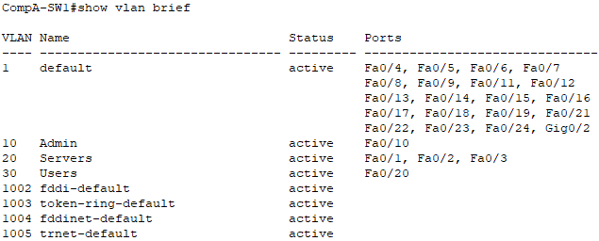
VLAN
INTERNET
TECHNOLOGIES
Connection to Router
Broadcast isolation security
Different access policies per VLAN
Flexibility in reorganization
Broadcast domain reduction
Isolation security
Flexible management
Granular access policies
Switch Configuration (CompA-SW1)

Slide 8
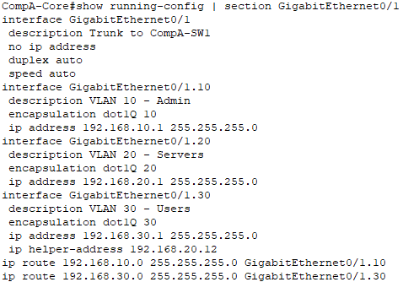
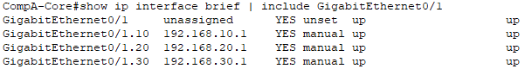
INTERNET
TECHNOLOGIES
ROUTER-ON-A-STICK
1 physical port → 3 logical interfaces
Each VLAN has its own gateway
DHCP for relay between VLANs
All interfaces are UP/UP (functional)

Slide 9
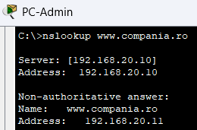
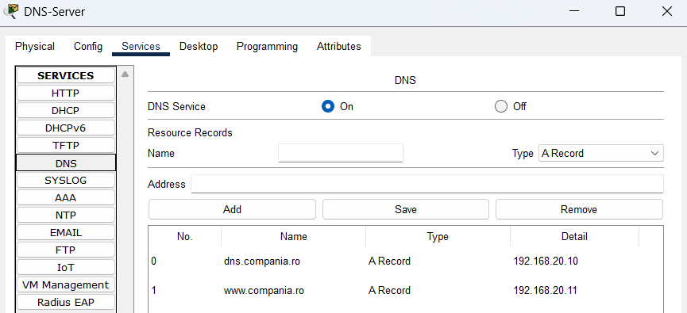
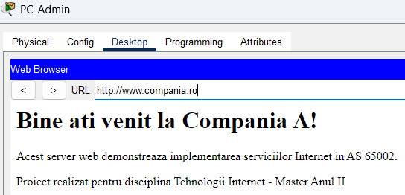
DNS
INTERNET
TECHNOLOGIES
2. Testing
1. Configuration
3. Real application

Slide 10
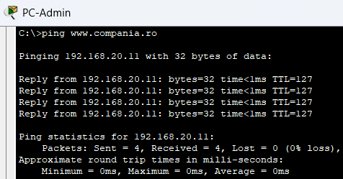
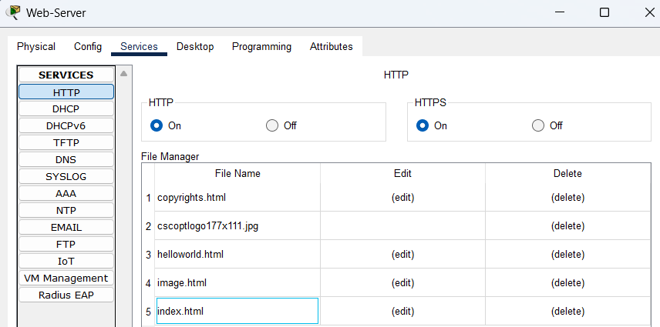
WEB SERVER
INTERNET
TECHNOLOGIES

Slide 11
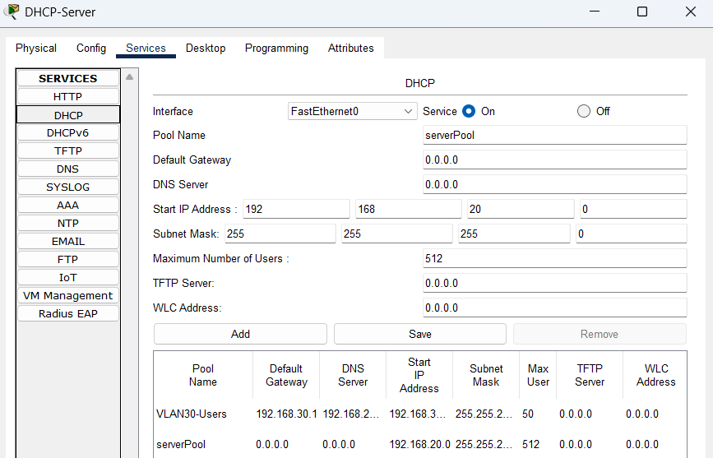
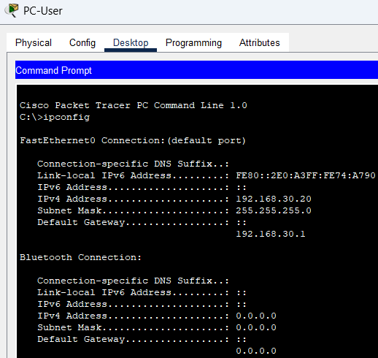
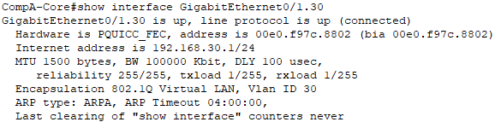
DHCP
INTERNET
TECHNOLOGIES

Slide 12
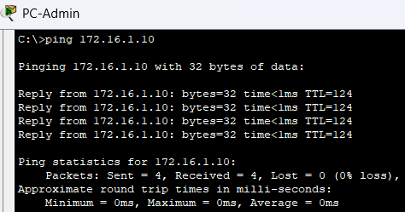
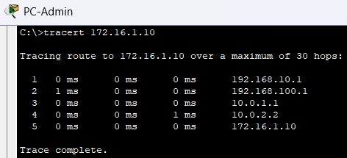
INTERNET
TECHNOLOGIES
TESTING (CONNECTIVITY)
Ping: 0% packet loss
Traceroute: 5 hops through 3 ASs
PC-Admin → VLAN 10 → CompA-Core → CompA-Border → ISP → CompB-Border → PC-CompB1

Slide 13
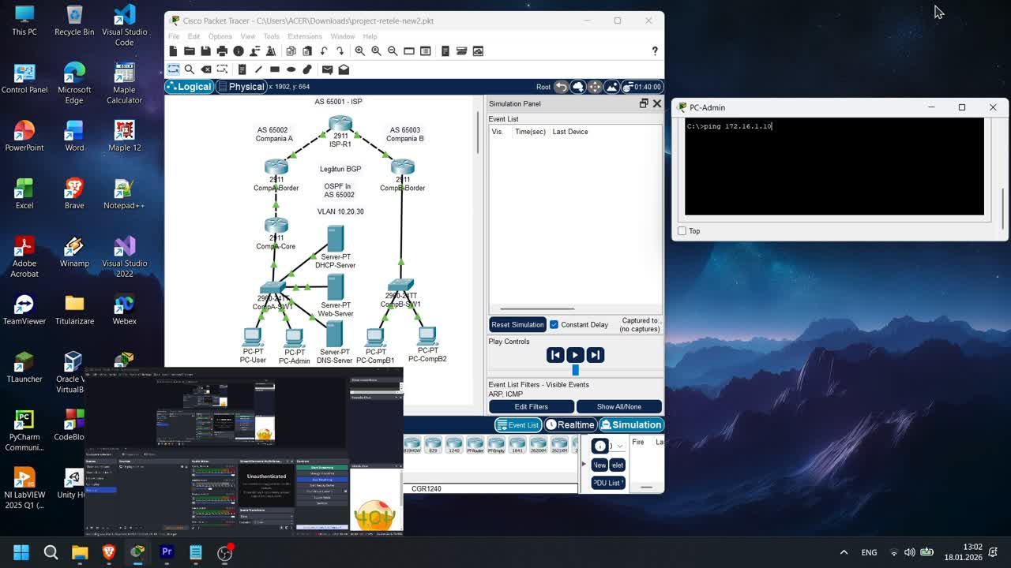
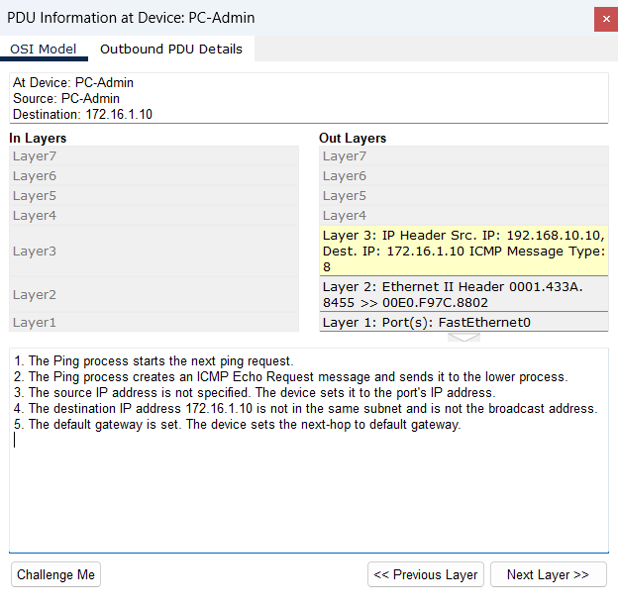
INTERNET
TECHNOLOGIES
SIMULATION MODE

Slide 14
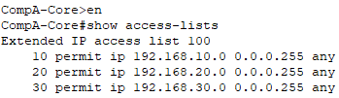
SECURITY
INTERNET
TECHNOLOGIES
VLAN Isolation (Layer 2): ​​Physical separation of broadcast domains
ACL Filtering (Layer 3): Granular IP-based control
Defense in Depth: Multiple layers of security
Strat | Tehnology | Protection
Layer 2 | VLAN | Department isolation
Layer 3 | ACL | Traffic filtering
Layer 4 | (Future) Firewall | Stateful inspection

Slide 15

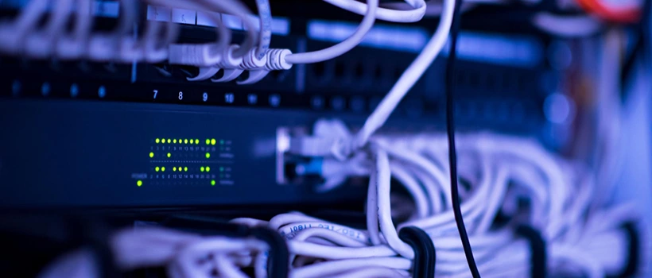
INTERNET
TECHNOLOGIES
CONCLUSIONS
Achievements:
Multi-AS architecture with BGP for routing between autonomous systems
OSPF for fast and scalable internal routing
Network segmentation via VLANs and router-on-a-stick
Integrated services: DNS, HTTP, DHCP
Full validated connectivity between all nodes
Perspectives:
Future extensions: firewall, BGP redundancy, IPv6
Solid foundation for real enterprise deployments

Slide 16

INTERNET
TECHNOLOGIES
THANK YOU!

